Slide 1
Leadership
Leadership skills are the qualities individuals of influential roles possess to direct and complete tasks, support initiatives, create a sense of unity within a team, and empower others.
To Lead, you must be able to connect, motivate, and inspire a sense of ownership of shared objectives.

Slide 2
“ Tell me and I will forget. Show me and I may remember.
Involve me and I will understand.”

Slide 3
The Action of leading a group of people or an organization
Leadership
Notes:
defination

Slide 4
Leadership Role
Your leadership role as an Auxiliary President is to inspire and motivate others, to create a vision of the future that is vivid and compelling and that motivates members to want to be active and achieve. Everyone wants to be a part of something that makes a difference in their community. As a leader, you are best able to help the members of your team connect what they do in their community with the impact of our mission of service to our veterans, military and their families.
Great leaders have integrity, are honest and take responsibility. Be a good role model

Slide 5
Leadership role
3. Communicate with your members often and in a variety of different ways, whether by one‐on‐one conversations, team meetings, blog posts, email, phone, video conferencing (e.g., Zoom) or any other

Slide 6
Leadership Role
4. As a Leader, you will need to communicate regularly with your Auxiliary, District, Department and VFW Post throughout your term of office.
5. Help set goals for your Auxiliary, but be a team player. Work closely with your Secretary and Treasurer.
6. When making decisions, take time to think it through, do research or ask a mentor for advice. Your decision should be rendered in a kind but firm manner, consistent and fair to all.

Slide 7
Leadership Role
7. There are many things to accomplish and many tasks to perform during the year. To keep them from getting overwhelming, learn how to assign duties to other members. Ask in a personal way and be specific about what you are asking to be done and the time commitment necessary.
8. Be sure that Officers, Trustees and other positions get the training needed. If you need assistance in this area, check the Department and National websites for resources or contact your Department Secretary or Chief of Staff for guidance.

Slide 8
Leadership Role
9. Remember to say “Thank you” at all times.
10. Wear a smile and have an upbeat tone in your voice.
Remember, we are all volunteers.

Slide 9
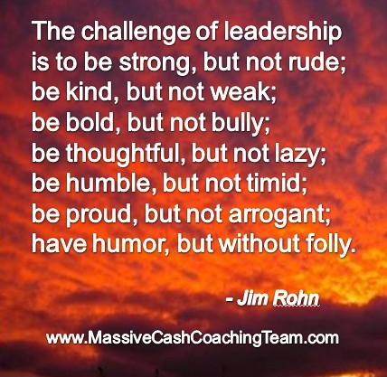
This Photo by Unknown Author is licensed under CC BY-NC-ND

